Slide 1
Theory of Games: Part II
Rajiv Sethi and the CORE Team
October 13, 2022

Slide 2
Overview
Games with many players
Games with a sequence of moves
Mixed strategies
Does game theory assume that people are self-interested?
Reading: The Economy Units 4.6, 4.10, 4.13 to 4.14

Slide 3
Games With Many Players

Slide 4
Many Players
For most economic applications, need to consider many players
Firms in an industry, countries in the world, drivers on a road
Payoffs cannot be represented using matrices
But in some case, payoffs depend only on aggregate choice by others
Examples: greenhouse gas emissions, contributions to charity

Slide 5
Pollution
Four paper manufacturing firms, each located by a water source
Each can clean wastewater before discharge, or choose to pollute
Cost of cleaning before discharge is $10 million
If any firm pollutes, intake water must be treated
Cost of treating before use is lower when fewer firms pollute
For each polluting firm, treatment cost rises by $8 million (range 0-32)
Each player’s payoff depends on her choice and aggregate pollution
What does the payoff matrix look like?
Do players have a dominant strategy?
What is an equilibrium strategy profile?

Slide 6
 |  | Other Three Firms
 |  | All Clean | 1 Pollutes | 2 Pollutes | 3 Pollutes
Your Firm | Clean | -10 | -18 | -26 | -34
 | Pollute | -8 | -16 | -24 | -32
Your firm’s payoffs (costs of cleaning plus treatment) given choices by other firms

Slide 7
 |  | Other Three Firms
 |  | All Clean | 1 Pollutes | 2 Pollutes | 3 Pollutes
Your Firm | Clean | -10 | -18 | -26 | -34
 | Pollute | -8 | -16 | -24 | -32
Your firm’s payoffs (costs of cleaning plus treatment) given choices by other firms

Slide 8
 |  | Other Three Firms
 |  | All Clean | 1 Pollutes | 2 Pollutes | 3 Pollutes
Your Firm | Clean | -10 | -18 | -26 | -34
 | Pollute | -8 | -16 | -24 | -32
Your firm’s payoffs (costs of cleaning plus treatment) given choices by other firms

Slide 9
 |  | Other Three Firms
 |  | All Clean | 1 Pollutes | 2 Pollutes | 3 Pollutes
Your Firm | Clean | -10 | -18 | -26 | -34
 | Pollute | -8 | -16 | -24 | -32
Your firm’s payoffs (costs of cleaning plus treatment) given choices by other firms

Slide 10
 |  | Other Three Firms
 |  | All Clean | 1 Pollutes | 2 Pollutes | 3 Pollutes
Your Firm | Clean | -10 | -18 | -26 | -34
 | Pollute | -8 | -16 | -24 | -32
Your firm’s payoffs (costs of cleaning plus treatment) given choices by other firms

Slide 11
 |  | Other Three Firms
 |  | All Clean | 1 Pollutes | 2 Pollute | 3 Pollute
Your Firm | Clean | -10 | -18 | -26 | -34
 | Pollute | -8 | -16 | -24 | -32
Dominant Strategy Equilibrium

Slide 12
Policy Implications
If all are allowed to pollute freely, all are worse off
All firms may prefer imposition of fines for pollution
Similar effects arise with carbon emissions and climate change
Also with traffic congestion: tolls can make all drivers better off
Imagine if there were no fines for violating traffic laws
Also with taxation: a purely voluntary system would break down
Fines for tax evasion may have widespread popular support

Slide 13
Games with a Sequence of Moves

Slide 14
Games with Sequence of Moves
Consider games (like chess) which involve a sequence of moves
What is a strategy in such a game?
A complete, contingent plan of action
Must specify the move to be made in every contingency that might arise
Chess has more strategies than atoms in the universe
A simpler example: ultimatum bargaining

Slide 15
Ultimatum Bargaining
Two players: proposer (you) and responder (me)
They share $100 if they can agree on how to divide it
Proposer can suggest either (50, 50) or (80, 20)
Responder can either accept or reject
Rejection results in zero payoffs to each player
How many strategies does the proposer have?
How many strategies does the responder have?
Hint: the answer is not two!

Slide 16
Responder Strategies
Proposer has two strategies (offer 50 or offer 20)
Responder has four strategies
Accept both offers, reject both, accept only 50, accept only 20
What does equilibrium look like?
Can represent and study this interaction using a game tree

Slide 17
You
Offer (50, 50)
Offer (80, 20)
Me
Me
Accept (50, 50)
Reject (0, 0)
Accept (80, 20)
Reject (0, 0)

Slide 18
Backward Induction
Suppose both of us care only about money and both know this
You put yourself in my position
For each proposal by you, what would I choose?
If I care only about money, accept either way
If you know this, suggest (80, 20) split, which is accepted
This is a Nash equilibrium
Is there another equilibrium?

Slide 19
You
Offer (50, 50)
Offer (80, 20)
Me
Me
Accept (50, 50)
Reject (0, 0)
Accept (80, 20)
Reject (0, 0)
A Nash equilibrium in the ultimatum game

Slide 20
You
Offer (50, 50)
Offer (80, 20)
Me
Me
Accept (50, 50)
Reject (0, 0)
Accept (80, 20)
Reject (0, 0)
An equilibrium based on a threat that is not credible

Slide 21
Game Theory and Self-Interest

Slide 22
Envy, Spite, and Reciprocity
We have seen that game theory can incorporate guilt and humiliation
It can also accommodate altruism, envy, spite, and reciprocity
Suppose that an unfair offer upsets the responder
Punishing the proposer has greater value than money from acceptance
Specifically, rejection of unfair offer yields payoff 30
Then the ultimatum game is transformed
The threat of rejection becomes credible
Caring less about money gets the responder more money in equilibrium

Slide 23
You
Offer (50, 50)
Offer (80, 20)
Me
Me
Accept (50, 50)
Reject (0, 0)
Accept (80, 20)
Reject (0, 30)

Slide 24
Golden Balls Revisited
Preferences over outcomes may depend on factors other than money
For example: choosing split when other steals may be upsetting
Player choosing split may feel exploited, hurt, angry, humiliated
Suppose this outcome feels like a loss of $1,000
How does this affect the nature of the game?
How is the payoff matrix affected?

Slide 25
 |  | Me
 |  | Split | Steal
You | Split | (10,000, 10,000) | (-1,000, 20,000)
 | Steal | (20,000, -1,000) | (0, 0)

Slide 26
Best Responses and Dominant Strategies

Slide 27
Best Responses
Suppose the choices of others are held fixed but I can choose mine
A strategy that gives me the highest payoff is a best response
In general, my best response depends on what others choose
But sometimes best response is the same no matter what others choose
In this case we say that a player has a (strictly) dominant strategy
Do players have a dominant strategy in (modified) golden balls?

Slide 28
 |  | Me
 |  | Split | Steal
You | Split | (10,000, 10,000) | (-1,000, 20,000)
 | Steal | (20,000, -1,000) | (0, 0)

Slide 29
 |  | Me
 |  | Split | Steal
You | Split | (10,000, 10,000) | (-1,000, 20,000)
 | Steal | (20,000, -1,000) | (0, 0)

Slide 30
Dominant Strategy Equilibrium
Suppose all players have a dominant strategy
Then the game has a dominant strategy equilibrium
Golden balls (modified) has a dominant strategy equilibrium
What do players choose in this equilibrium?
What payoffs to they get when making these choices?
Is there a strategy profile at which they would both be better off?
Why don’t they play in accordance with this (better) strategy profile?

Slide 31
Another Modification
Now suppose plyers not only feel humiliation, but also guilt
They feel bad if they choose steal and the other chooses to split
So bad that the effective payoff is not 20,000 but just 5,000
What does the payoff matrix look like in this game?
What are the best responses?
Is there a dominant strategy equilibrium?

Slide 32
 |  | Me
 |  | Split | Steal
You | Split | (10,000, 10,000) | (-1,000, 5,000)
 | Steal | (5,000, -1,000) | (0, 0)

Slide 33
 |  | Me
 |  | Split | Steal
You | Split | (10,000, 10,000) | (-1,000, 5,000)
 | Steal | (5,000, -1,000) | (0, 0)

Slide 34
Nash Equilibrium

Slide 35
Nash Equilibrium
Consider a profile of strategies, one for each player
Example: (Split, Steal) is a strategy profile, as is (Steal, Steal)
Profile is a Nash equilibrium if each strategy is best response to the other
No player has incentive to deviate unilaterally from a Nash equilibrium
How many Nash equilibria in Golden Balls (with humiliation and guilt)?

Slide 36
 |  | Me
 |  | Split | Steal
You | Split | (10,000, 10,000) | (-1,000, 5,000)
 | Steal | (5,000, -1,000) | (0, 0)

Slide 37
Mixed Strategies

Slide 38
Existence of Equilibrium
Some games have multiple Nash equilibria
But do all games have at least one equilibrium?
Consider Rock-Paper-Scissors
Winner gets $10 from loser
Both get zero if nobody wins
What does the payoff matrix look like?

Slide 39
 |  | Me
 |  | Rock | Paper | Scissors
You | Rock | (0, 0) | (-10, 10) | (10, -10)
 | Paper | (10, -10) | (0, 0) | (-10, 10)
 | Scissors | (-10,10) | (10, -10) | (0, 0)

Slide 40
 |  | Me
 |  | Rock | Paper | Scissors
You | Rock | (0, 0) | (-10, 10) | (10, -10)
 | Paper | (10, -10) | (0, 0) | (-10, 10)
 | Scissors | (-10,10) | (10, -10) | (0, 0)

Slide 41
 |  | Me
 |  | Rock | Paper | Scissors
You | Rock | (0, 0) | (-10, 10) | (10, -10)
 | Paper | (10, -10) | (0, 0) | (-10, 10)
 | Scissors | (-10,10) | (10, -10) | (0, 0)

Slide 42
 |  | Me
 |  | Rock | Paper | Scissors
You | Rock | (0, 0) | (-10, 10) | (10, -10)
 | Paper | (10, -10) | (0, 0) | (-10, 10)
 | Scissors | (-10,10) | (10, -10) | (0, 0)

Slide 43
Another Example
Consider an all-pay auction
Highest bidder gets prize but all bidders must pay their bid
If many bidders tie for highest bid, prize is shared by them equally
Applications: lobbying, arms races, patent races, scientific research
Can we model this as a game?

Slide 44
All-Pay Auction
All-pay auctions: highest bidder wins but all bidders pay their bids
Consider two bidders, prize has value 2.50
Three possible bids: 0, 1, and 2
Highest bidder gets 2.50 minus bid, other bidder loses bid
If tied they share the prize: each get 1.25 minus bid
This way we can build a payoff matrix

Slide 45
 |  | Me
 |  | Bid 0 | Bid 1 | Bid 2
You | Bid 0 | (1.25, 1.25) | (0, 1.50) | (0, 0.50)
 | Bid 1 | (1.50, 0) | (0.25, 0.25) | (-1, 0.50)
 | Bid 2 | (0.50, 0) | (0.50, -1) | (-0.75, -0.75)

Slide 46
 |  | Me
 |  | Bid 0 | Bid 1 | Bid 2
You | Bid 0 | (1.25, 1.25) | (0, 1.50) | (0, 0.50)
 | Bid 1 | (1.50, 0) | (0.25, 0.25) | (-1, 0.50)
 | Bid 2 | (0.50, 0) | (0.50, -1) | (-0.75, -0.75)

Slide 47
 |  | Me
 |  | Bid 0 | Bid 1 | Bid 2
You | Bid 0 | (1.25, 1.25) | (0, 1.50) | (0, 0.50)
 | Bid 1 | (1.50, 0) | (0.25, 0.25) | (-1, 0.50)
 | Bid 2 | (0.50, 0) | (0.50, -1) | (-0.75, -0.75)

Slide 48
 |  | Me
 |  | Bid 0 | Bid 1 | Bid 2
You | Bid 0 | (1.25, 1.25) | (0, 1.50) | (0, 0.50)
 | Bid 1 | (1.50, 0) | (0.25, 0.25) | (-1, 0.50)
 | Bid 2 | (0.50, 0) | (0.50, -1) | (-0.75, -0.75)

Slide 49
Best Responses
If the I bid 0, what is your best response?
What if I bid 1?
What if I bid 2?
Does this game have a Nash equilibrium?
What if we randomize over the available bids?
These are called mixed strategies

Slide 50
Mixed Strategies
Suppose players can randomize over their available strategies
Instead of choosing a strategy, choose a probability distribution
Example: choose each of the three bids with probability 1/3
This is a mixed strategy (underlying strategies are pure strategies)
In this case we consider expected payoffs

Slide 51
Expected Payoffs
What if we both randomize?
Suppose I bid 1 and 2 with equal probability
You bid 0 and 1 with equal probability
Think of probability for each cell of the matrix

Slide 52
 |  | Me
 |  | Bid 0 | Bid 1 | Bid 2
You | Bid 0 | (1.25, 1.25) | (0, 1.50) | (0, 0.50)
 | Bid 1 | (1.50, 0) | (0.25, 0.25) | (-1, 0.50)
 | Bid 2 | (0.50, 0) | (0.50, -1) | (-0.75, -0.75)

Slide 53
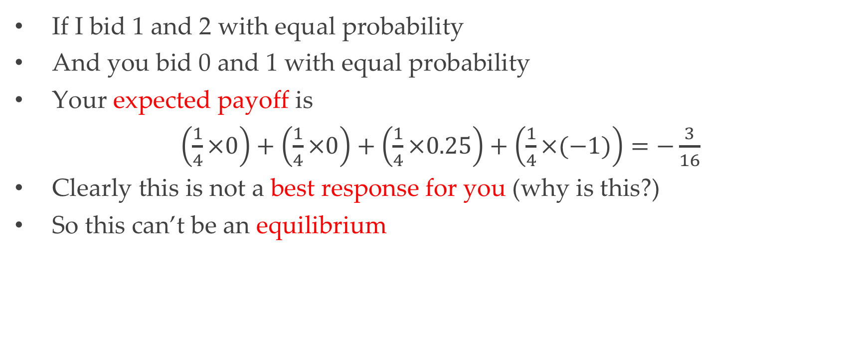
Expected Payoffs
If I bid 1 and 2 with equal probability
And you bid 0 and 1 with equal probability
Your expected payoff is
$\left(\frac{1}{4}×0\right)+\left(\frac{1}{4}×0\right)+\left(\frac{1}{4}×0.25\right)+\left(\frac{1}{4}×(−1)\right)=−\frac{3}{16}$
Clearly this is not a best response for you (why is this?)
So this can’t be an equilibrium

Slide 54
Equilibrium in the All-Pay Auction
Equilibrium: profile of distributions where none can profitably deviate
Nash’s Theorem: every finite game has an equilibrium
What’s an equilibrium in the all-pay-auction?
Bid 1 with probability 3/5, bid 0 and 2 with probability 1/5 each
If I choose this, all of your strategies yield same expected payoff
If you choose this, all of my strategies yield same expected payoff
No player can profitably deviate; this is a Nash equilibrium
What is each player’s expected payoff in equilibrium? Answer: 0.25

Slide 55
Conclusions

Slide 56
Limitations of Nash Equilibrium
Does Nash equilibrium predict behavior well?
Consider half-the-average
Many players each can choose a number between 0 and 100 (inclusive)
Could choose 0, or 100, or anything in between, including decimals
Winner is player (or players) whose number is closest to half-the-average
Prize $100 is received by winner (or shared by winners)
All others get nothing
What is the unique Nash equilibrium?
What do people actually choose?

Slide 57
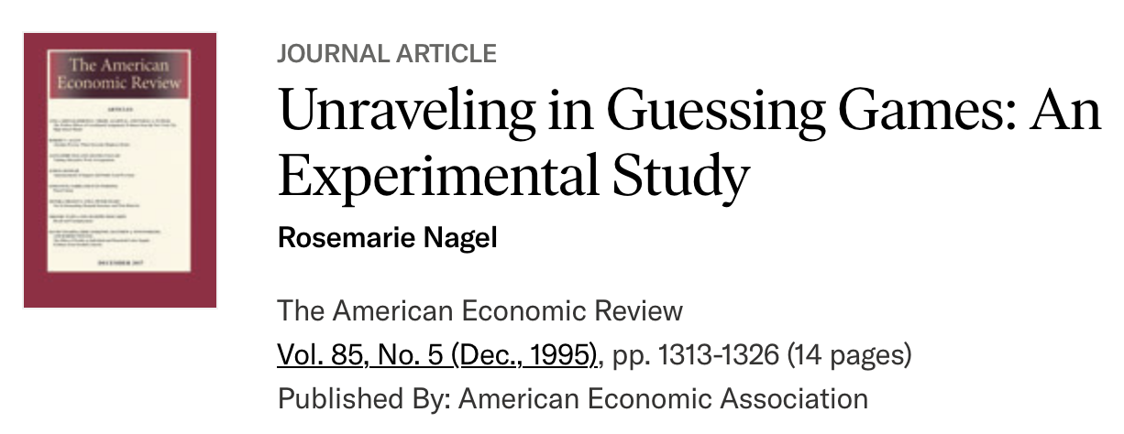

Slide 58
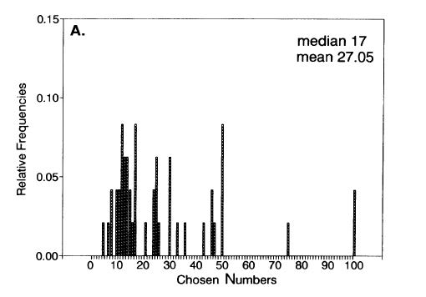

Slide 59
Conclusion
Game theory: a versatile language for the analysis of strategic interaction
Applications in economics, political science, evolutionary biology
The theory can accommodate preferences for altruism, spite, reciprocity
Laboratory experiments reveal wide variety of social preferences
Nash equilibrium works well in some games, poorly in others
Alternative solution concepts rely on different conceptions of rationality

